Slide 1

WEBSITE OF CLINIC MANAGEMENT SYSTEM
SUPERVISOR:
TEAM MEMBERS:
MR. NGUYEN VAN SANG
60195 PHAM KHUONG DUY
60390 NGUYEN VAN HON
SE60620 LE NGOC THANH
60041 LE VAN HUNG

Slide 2

PRESENTATION OUTLINE
1. Project overview
3. Software specification
4. Software design
6. Project result
7. Demo
2. Project management
5. Testing

Slide 3

Problem
Solution
Idea
PROJECT
OVERVIEW

Slide 4

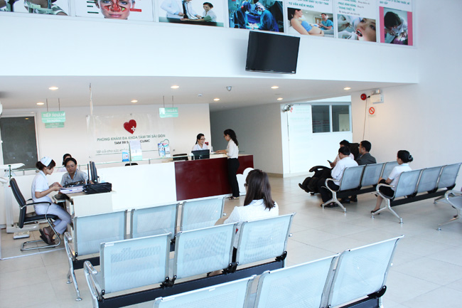
PROJECT OVERVIEW - Problem
Nowadays, most of clinic does not use technology for manage document.
The patients do not interact well with clinic system

Slide 5
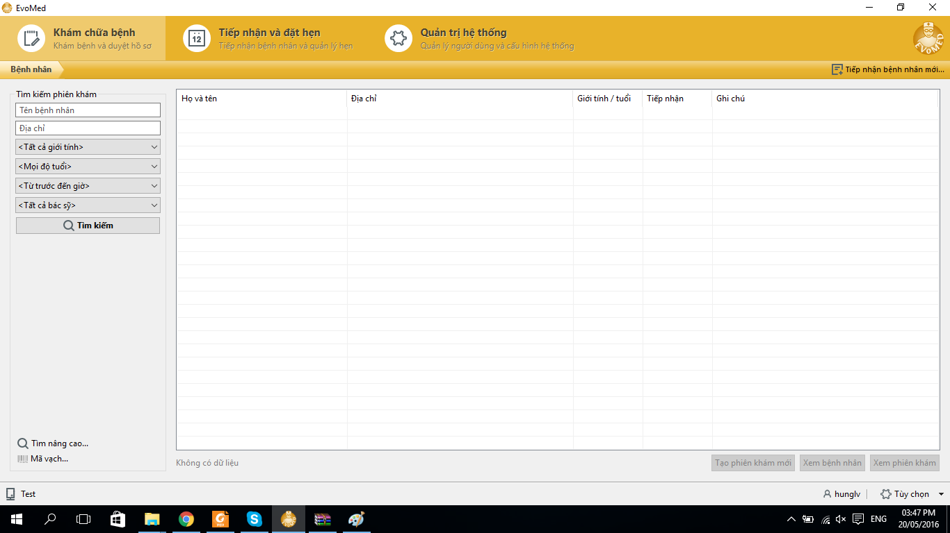
PROJECT OVERVIEW - Problem

Slide 6




PROJECT OVERVIEW - Problem
Many errors occur
Difficult to upgrade or maintain
Limit number of devices can use
Manage only 1 clinic

Slide 7

PROJECT OVERVIEW - Idea
Functional:
Manage Staff, Room, Service, Medicines, Patients …
Manage Process Of Medical Examination
Booking appointment
Statistic
Notes:
Quan li staff,room,service,medicines.patients
Quan li qua trinh kham benh reception tao va in phieu kham, nurse update phieu kham,doctor verify phieu kham, manager xem lai phieu kham
Dat lich hen
Thong ke

Slide 8
PROJECT OVERVIEW - Idea
Non-Functional:
Learnable
Easy upgrade and maintenance
Performance
Reliable

Slide 9
PROJECT OVERVIEW - Solution
Why choose Website & .NET?
Popularity
Rich class library
Run on multi-device
Experience

Slide 10

Project Model
Organization Structure
Master Schedule
Deliverables
Tools & Environment
Project Life cycle
Objectives
PROJECT
MANAGEMENT
Notes:
Hệ thống. Tổ chức của tem.
Lịch trình, kế hoạch của dự án
Mục tiêu đưa ra
Deliverables: Các bàn giao

Slide 11

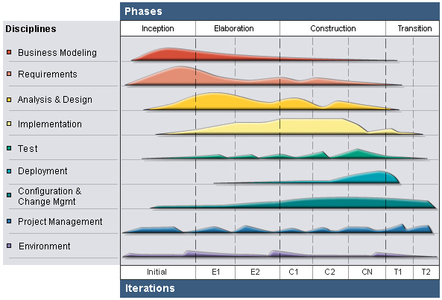
PROJECT MANAGEMENT – Project Model
RUP Model

Slide 12

PROJECT MANAGEMENT – Project Model
Why choose RUP?
Develop iteratively
Supports an iterative approach to development that addresses the highest risk items at every stage in the lifecycle, significantly reducing a project’s risk.
Very important for inexperienced team in controlling issues like us.
Manage requirements
Managing requirements during the whole development process ensures project team develops the right system with right requirements

Slide 13
PROJECT MANAGEMENT – Project Model
Why choose RUP?
Verify software quality
Testing process is implemented in all the cycles of application development time
Reduce risks

Slide 14
PROJECT MANAGEMENT – Project Life Cycle
Phase 1: Inception
Study business case and feasibility study of project
Complete project management plan
Complete draft ERD of system
Complete draft screen prototypes
Complete draft requirements
Determine project scopes

Slide 15
PROJECT MANAGEMENT – Project Life Cycle
Phase 2: Elaboration
Complete user requirement specification
Complete software requirement specification
Complete ERD, final prototypes
Complete database model
Complete system architecture design

Slide 16
PROJECT MANAGEMENT – Project Life Cycle
Phase 3: Construction
Complete coding and unit test
Complete user manual
Complete functional and regression test
Phase 4: Transition
Deploy website
Complete all reports and documents
Deliver source code

Slide 17
PROJECT MANAGEMENT – Organization Structure

Slide 18
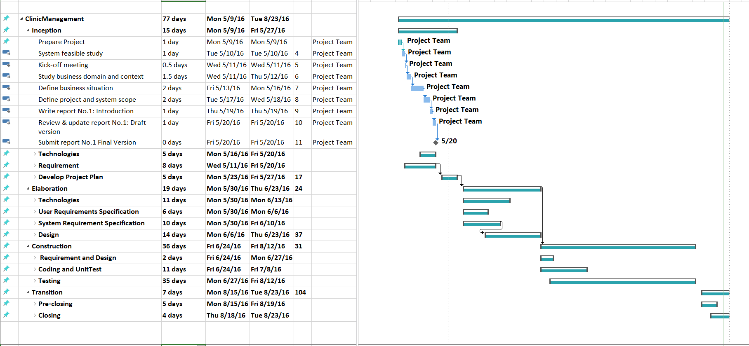
PROJECT MANAGEMENT – Master Schedule

Slide 19
PROJECT MANAGEMENT – Objects
Metrics | Unit | Committed | Actual | Deviation
Start Date | dd-mm-yyyy | 09-05-2016 | 09-05-2016 | 0 day
End Date | dd-mm-yyyy | 23-08-2016 | 24-08-2016 | 1 day
Duration | Elapsed days | 77 days | 78 days | 1 day
Maximum Team Size | Person | 4 | 4 | 0

Slide 20
PROJECT MANAGEMENT – Deliverables
No | Stage | Deliverable/ Milestone | Delivery Date | Delivery Location
1 | Inception | Deliver Report No.1 | 20-05-2016 | Supervisor
2 | Inception | Project plan | 25-05-2016 | Supervisor
3 | Inception | Deliver Report No.2 | 27-05-2016 | Supervisor
4 | Elaboration | Deliver Report No.3 | 10-06-2016 | Supervisor
5 | Elaboration | Deliver Report No.4 | 23-06-2016 | Supervisor
6 | Construction | Complete Coding | 08-07-2016 | Supervisor
7 | Construction | Deliver Report No.5 | 22-07-2016 | Supervisor
8 | Construction | Deliver Report No.6 | 29-07-2016 | Supervisor
9 | Transition | The last Document and CD source code | 24-08-2016 | FU
10 | Transition | Project completed | 24-08-2016 | FU

Slide 21









PROJECT MANAGEMENT – Tools & Environments

Slide 22

System Overview
Functional Requirement
Non Functional Requirement
SOFTWARE
SPECIFICATION

Slide 23

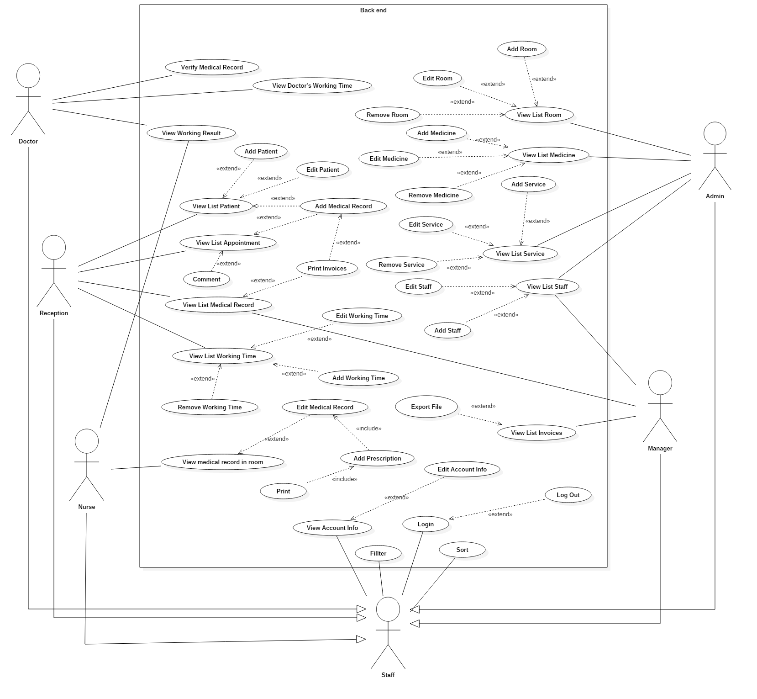
SOFTWARE SPECIFICATION – System Overview

Slide 24
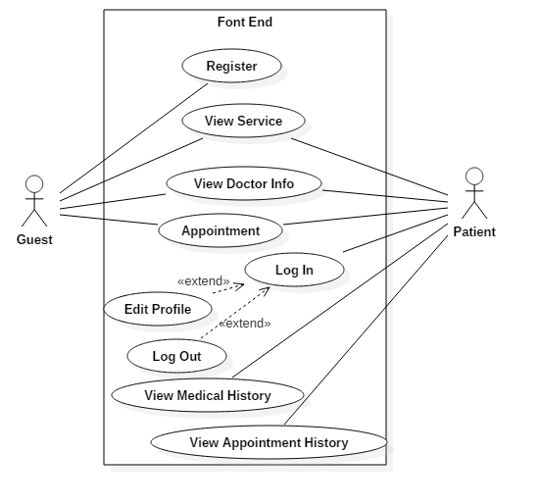
SOFTWARE SPECIFICATION – System Overview

Slide 25
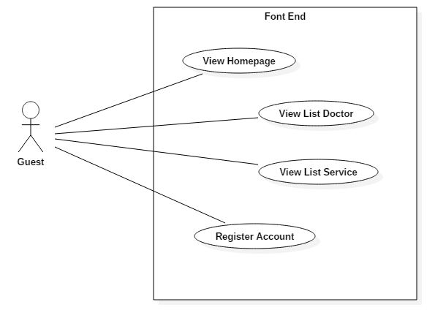
SOFTWARE SPECIFICATION – Functional Requirement

Slide 26
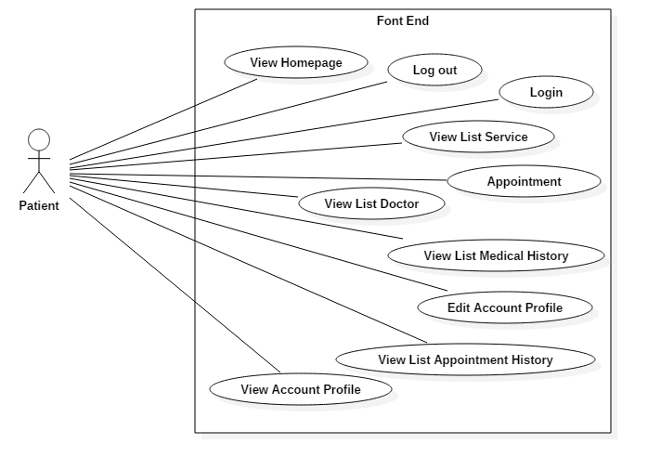
SOFTWARE SPECIFICATION – Functional Requirement

Slide 27
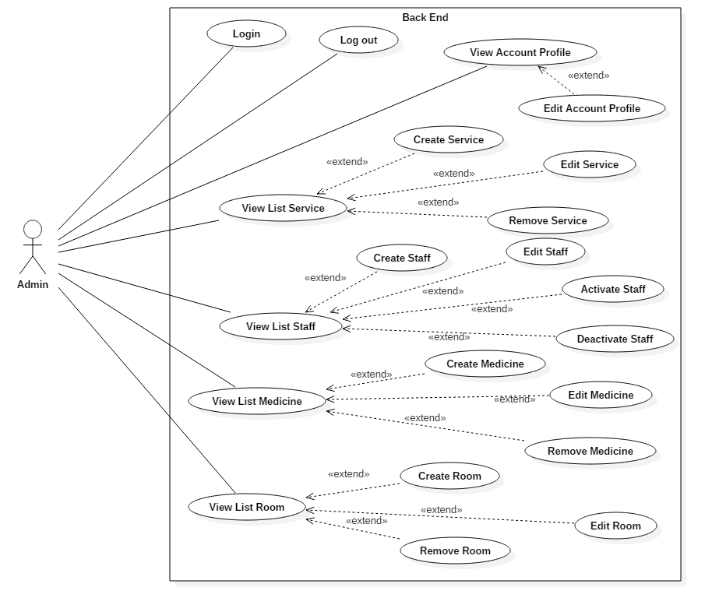
SOFTWARE SPECIFICATION – Functional Requirement

Slide 28
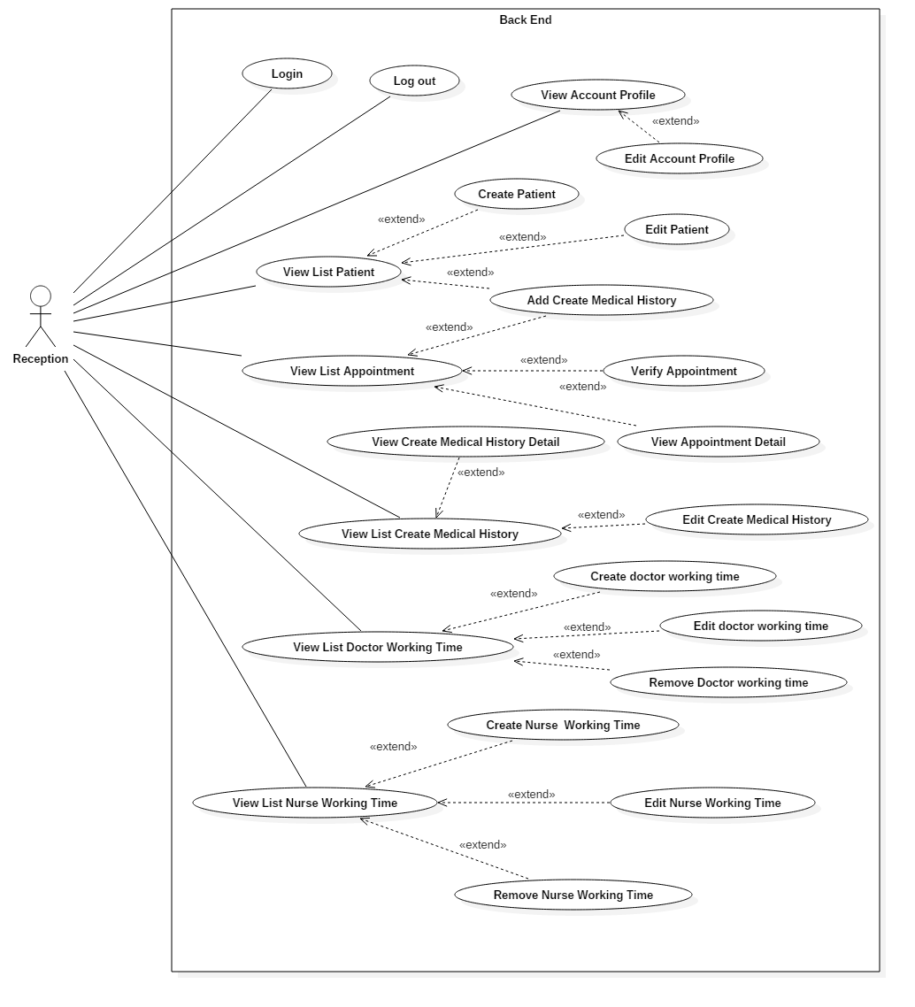
SOFTWARE SPECIFICATION – Functional Requirement

Slide 29
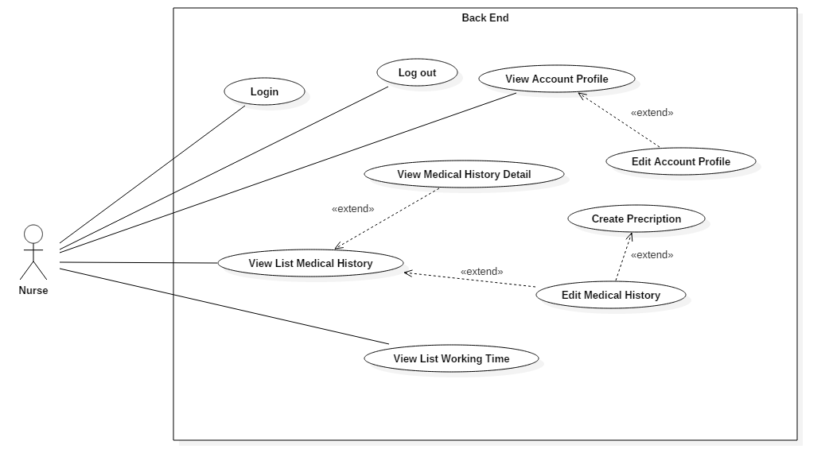
SOFTWARE SPECIFICATION – Functional Requirement

Slide 30
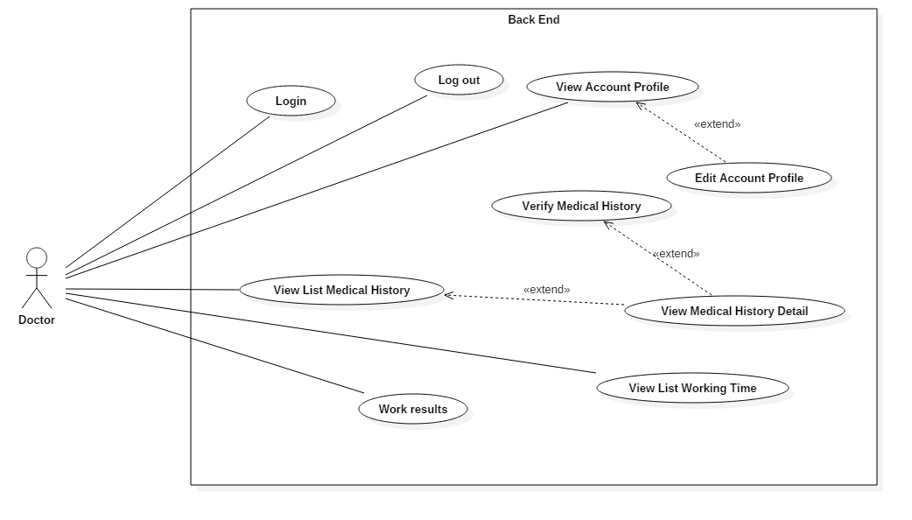
SOFTWARE SPECIFICATION – Functional Requirement

Slide 31
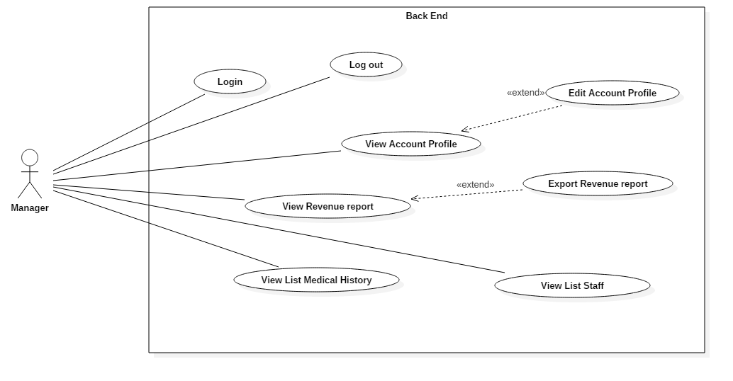
SOFTWARE SPECIFICATION – Functional Requirement

Slide 32
SOFTWARE SPECIFICATION – Nonfunctional Requirement
Learnable
The user interface must be easy to learn, even at the first time looking at the screen, user may immediately understand the function of each button or icon.
Performance
The system is approximately 99% and must be available 24 hours a day, 7 days a week.
User must have the ability to access website by any web browser in his or her computers.
Reliability
If the software is crashed, it should be repaired in 30 minutes.
Number of errors after one week trial: 2

Slide 33

Architecture Overview
Package Design
Database Design
SOFTWARE
DESIGN

Slide 34

SOFTWARE DESIGN – Architecture Overview

Slide 35
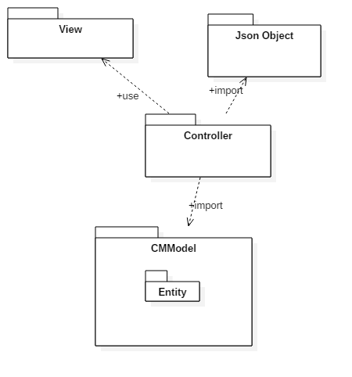
SOFTWARE DESIGN – Package Diagram

Slide 36
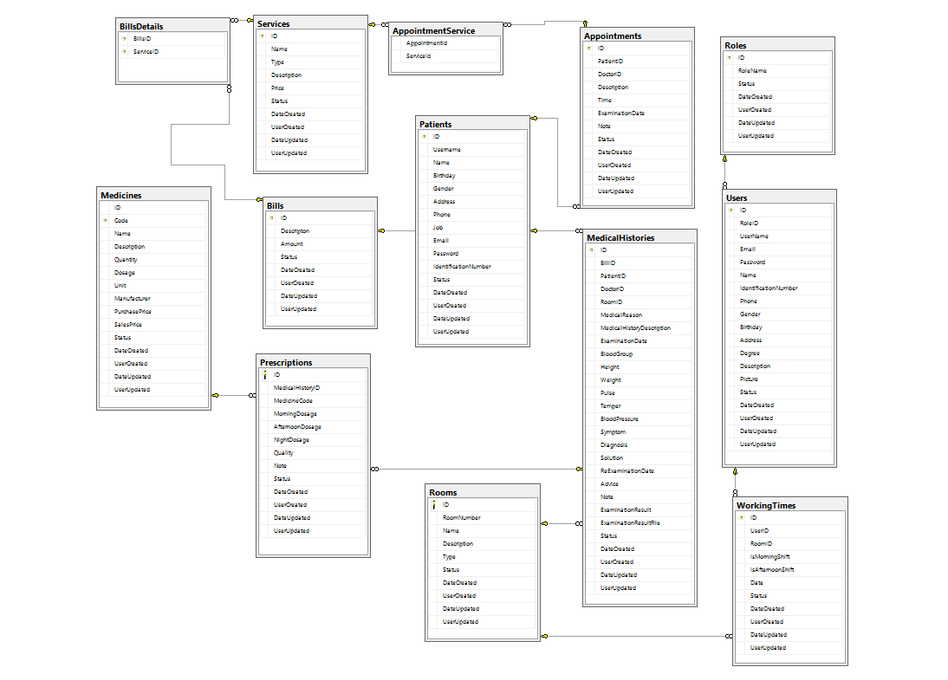
SOFTWARE DESIGN – Database Design

Slide 37

Test Model
Test Process
Test Result
TESTING

Slide 38

TESTING – Test Model
Customer requirement
validate
Acceptance test
Product specifications
verify/validate
System test
verify
High-level design
Integration test
other V&V activities
Low-level design
verify
Component test
Coding & unit test

Slide 39
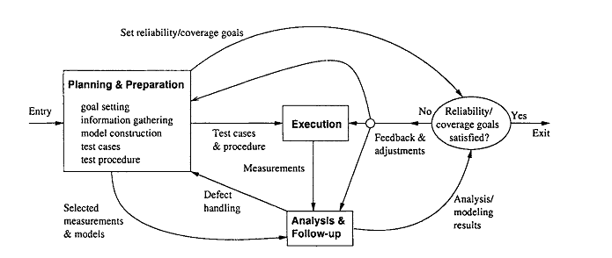
TESTING – Test Process

Slide 40
TESTING – Test Process
Planning & Preparation:
Goal setting: test stages, test item etc…
Test cases preparation
Test procedure preparation
Execution:
Executing test
Related activities: retest, report etc...
Analysis & Follow up:
Checking result
Analysis result

Slide 41
TESTING – Test Schedule
Unit test:
Doer : Developer
Time : 27/07-7/7
Integration test:
Doer : Test team
Time : 30/6 – 8/7
System test:
Doer : Test team
Time : 13/7 – 19/7

Slide 42
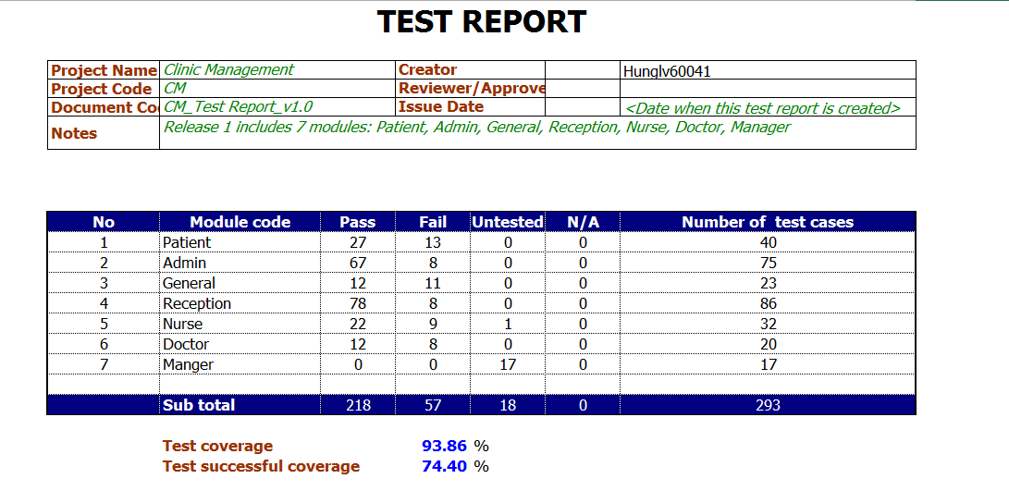
TESTING – Test Result

Slide 43
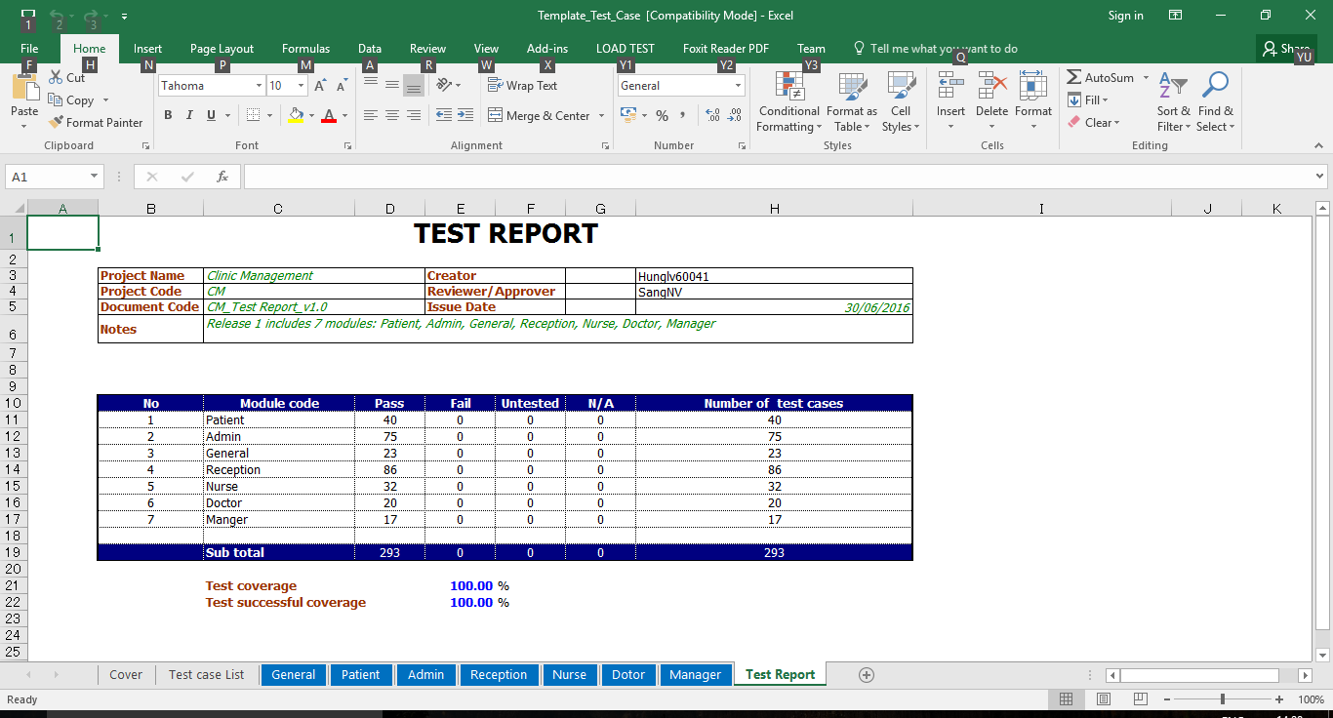
TESTING – Final Test Result

Slide 44

Project result
Comparison Result
Lesson Learned
PROJECT
RESULT

Slide 45

PROJECT RESULT – Project Result
After closing project, we achieve goal software:
All clinic staff can work more effective, easier and simpler way.
Clinic staff can manage all information like medicines, medical history, staff, service, room.
Patients can easily book appointment to meet doctor on time.

Slide 46
PROJECT RESULT – Project Result
We have more experiences of managing a software project: how to manage plan, time, and risk. These experiences help us a lot in our future work.
Know how to communicate with other team members and how to do teamwork efficiently

Slide 47
PROJECT RESULT – Comparison Result
Main objectives | Develop a website that helps users can manage all information like case, customer, staff, service and office easier.
Purpose | Lawyers can work more effective, easier and simpler
Items | Plan | Actual
Releases date | 23/08/2016 | 24/08/2016
Releases version | 1.0 | 1.0
Days | 77 | 78
Test cases | 250 test cases | 293 test cases
Defects | 50 | 57
Document pages | >200 | > 350 (include appendix)
Lines of code | N/A | Approximately 5000

Slide 48
PROJECT RESULT – Limitation & Expectation
Limitation:
Only support IE, Microsoft Edge
Expectation:
Develop more in other browser

Slide 49
PROJECT RESULT – Lesson Learned
Situation | Problem | Lessons learned
Conflict in team | Members are stress Cannot make decision | Talk and listen to each other Analysis situation Make right decisions
Technical difficulties | Take lots of time to solve Miss the deadline | Search in Google or some IT forums Ask group’s supervisor or teachers for some advices

Slide 50

DEMO
Authentication
Homepage
Manage Service, Staff, Room
Book Appointment
Process medical examination
Statistic

Slide 51


Slide 52
Thanks for watching

